Slide 1
An Introduction to SageMaker
Vishaal Kapoor
10 October 2018
Notes:
Mathew
Hyperopt
TPE (Tree Parzen Estimator)

Slide 2
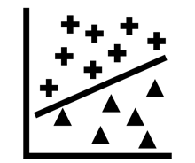
Roadmap
What can we do with Machine Learning and Deep Learning?
What are the pain points?
How does SageMaker mitigate those pain points and provide leverage?
Walk-throughs with SageMaker

Slide 3
1. What can we do with Machine Learning and Deep Learning

Slide 4
We can classify things
https://www.slideshare.net/butest/machine-learning-3860079
Notes:
Natural Language Processing
Sentiment analysis/mood

Slide 5



We can try to identify things in pictures
How many cats?
Complex tasks where you can’t code up explicit solutions
Notes:
ML was created to identify images of cats.

Slide 6
We can try to find correlations between things
http://upibi.org/penn-team-uses-machine-learning-and-twitter-to-predict-heart-disease-risk/
Notes:
Sentiment analysis -> Heart Disease
Natural Language Processing
Sentiment analysis/mood

Slide 7
We can assign topics to articles
https://medium.com/@connectwithghosh/topic-modelling-with-latent-dirichlet-allocation-lda-in-pyspark-2cb3ebd5678e
Notes:
Good examples:
Imagine x = longitude, y = latitude
Linearly separable: blue dots = people in USA; green dots = Canada
Non-Linearly separable: blue = people in a city, green = people outside city

Slide 8
When not to use machine learning?
USA Social Security numbers
Stripping suffixes off English words
Exact numerical solution required
Address verification
Notes:
Audience: better solution for each?
You could do these with NN e.g. learn an approximation for a numerical solution. But might not be the best solution.

Slide 9
Situating Deep Learning
Can machines think?
Can machines do what we can? (Turing, 1950)
AI
Machine Learning
Deep Learning
Data
Machine Learning
Answers
Rules
Notes:
Sometimes here people say “ML and DL” as if they were two different things.

Slide 10
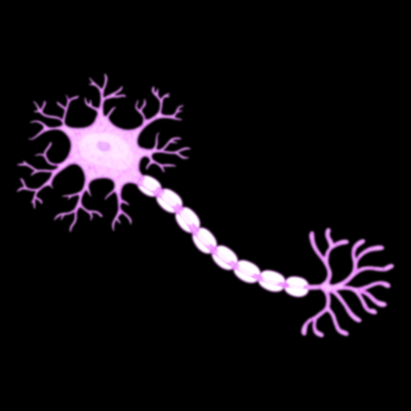

(Artificial) Neural Networks (ANN)
Inspired by the brain’s neurons
We have ~100B of them, and ~1Q Synapses
Inputs
Weights
Bias
Activation
b
x₁
w₁
$$y= φ(\sum_{j=1}^{n}{wjxj}+b)$$
Σ
φ
𝑦
x₂
w₂
…
x_{n}
w_{n}

Slide 11

Deep Neural Networks
Non-linear
Hierarchical feature learning
Scalable architecture
A Multilayer Perceptron (MLP)
Notes:
Hidden layers don’t all have to have the same number of neurons.
Output layer might be more than one.
This diagram shows a MLP for a task like classification, e.g. spam vs. non-spam

Slide 12
2. What are the pain points of ML and DL?

Slide 13

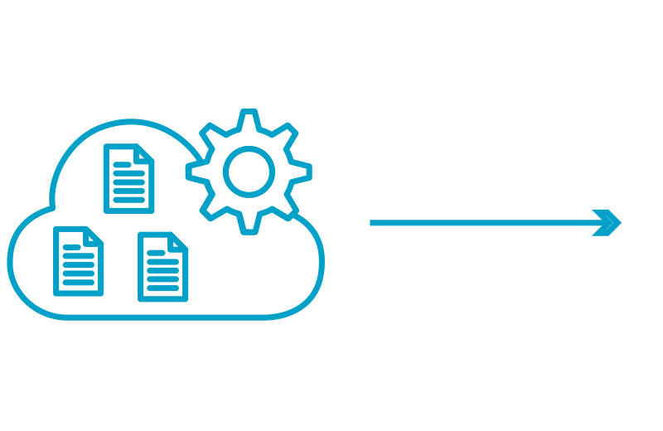
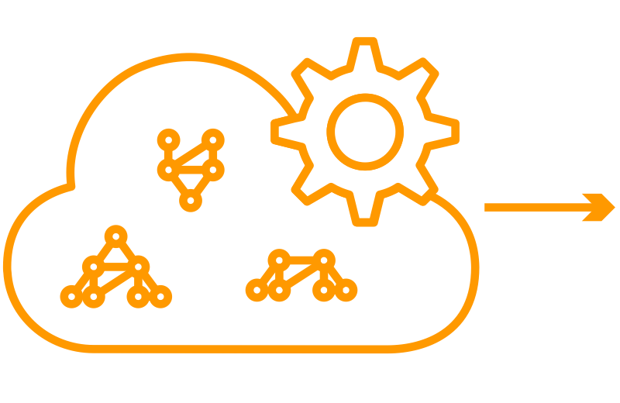
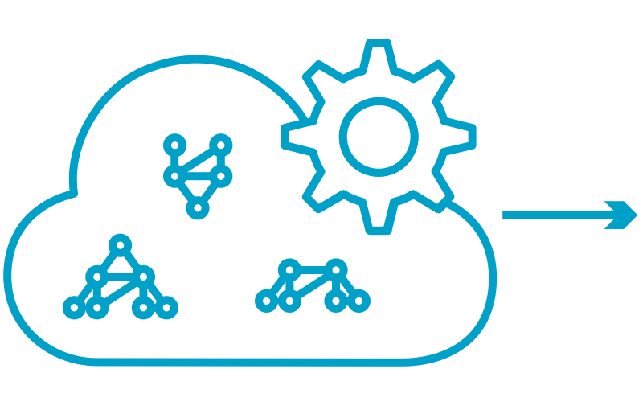
Machine Learning (and DL) to Production
Data +
Data Processing
Train & Tune
Deploy
Notes:
Need data: tweets, mortality rates, images of animals
Clean up data: supplement or remove incomplete data, resize and crop images
Train your statistical model
Deploy your model in the cloud so that it can be used to infer
Pain points:
Manually setting up the training workflow and managing it is a project in itself. Given an example.
Dealing with distributed training
Turning on and off the machines
Deploying to production means hosting a web service, writing software to handle incoming requests

Slide 14
3. How does SageMaker mitigate those pain points and provide leverage?

Slide 15


Using SageMaker Python SDK
Training Data
Estimator
Training Environment
.fit( )
train.py
.deploy( )
Trained Model
Predictor
Prediction Environment
.predict( )
endpoint
response
request
File by Iconstock from the Noun Project
?
Car

Slide 16
SageMaker Built-in Algorithms
Linear Learner
Image Classification Algorithm, Object Detection Algorithm
Factorization Machines, Principal Component Analysis (PCA)
K-Means Algorithm
K-Nearest Neighbors
Latent Dirichlet Allocation (LDA), Neural Topic Model (NTM)
Random Cut Forest, XGBoost Algorithm
BlazingText, Sequence2Sequence
DeepAR Forecasting

Slide 17
4. Walk-throughs with MXNet and SageMaker

Slide 18
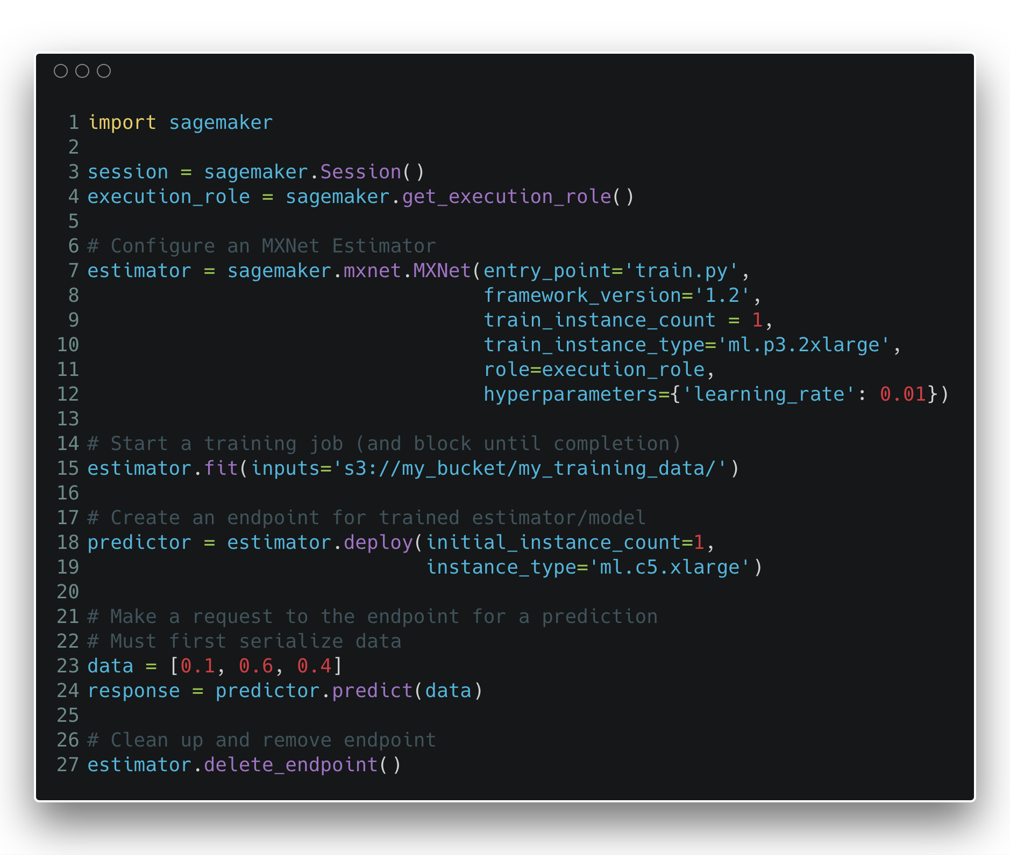
Using SageMaker Python SDK
Training
Inference

Slide 19
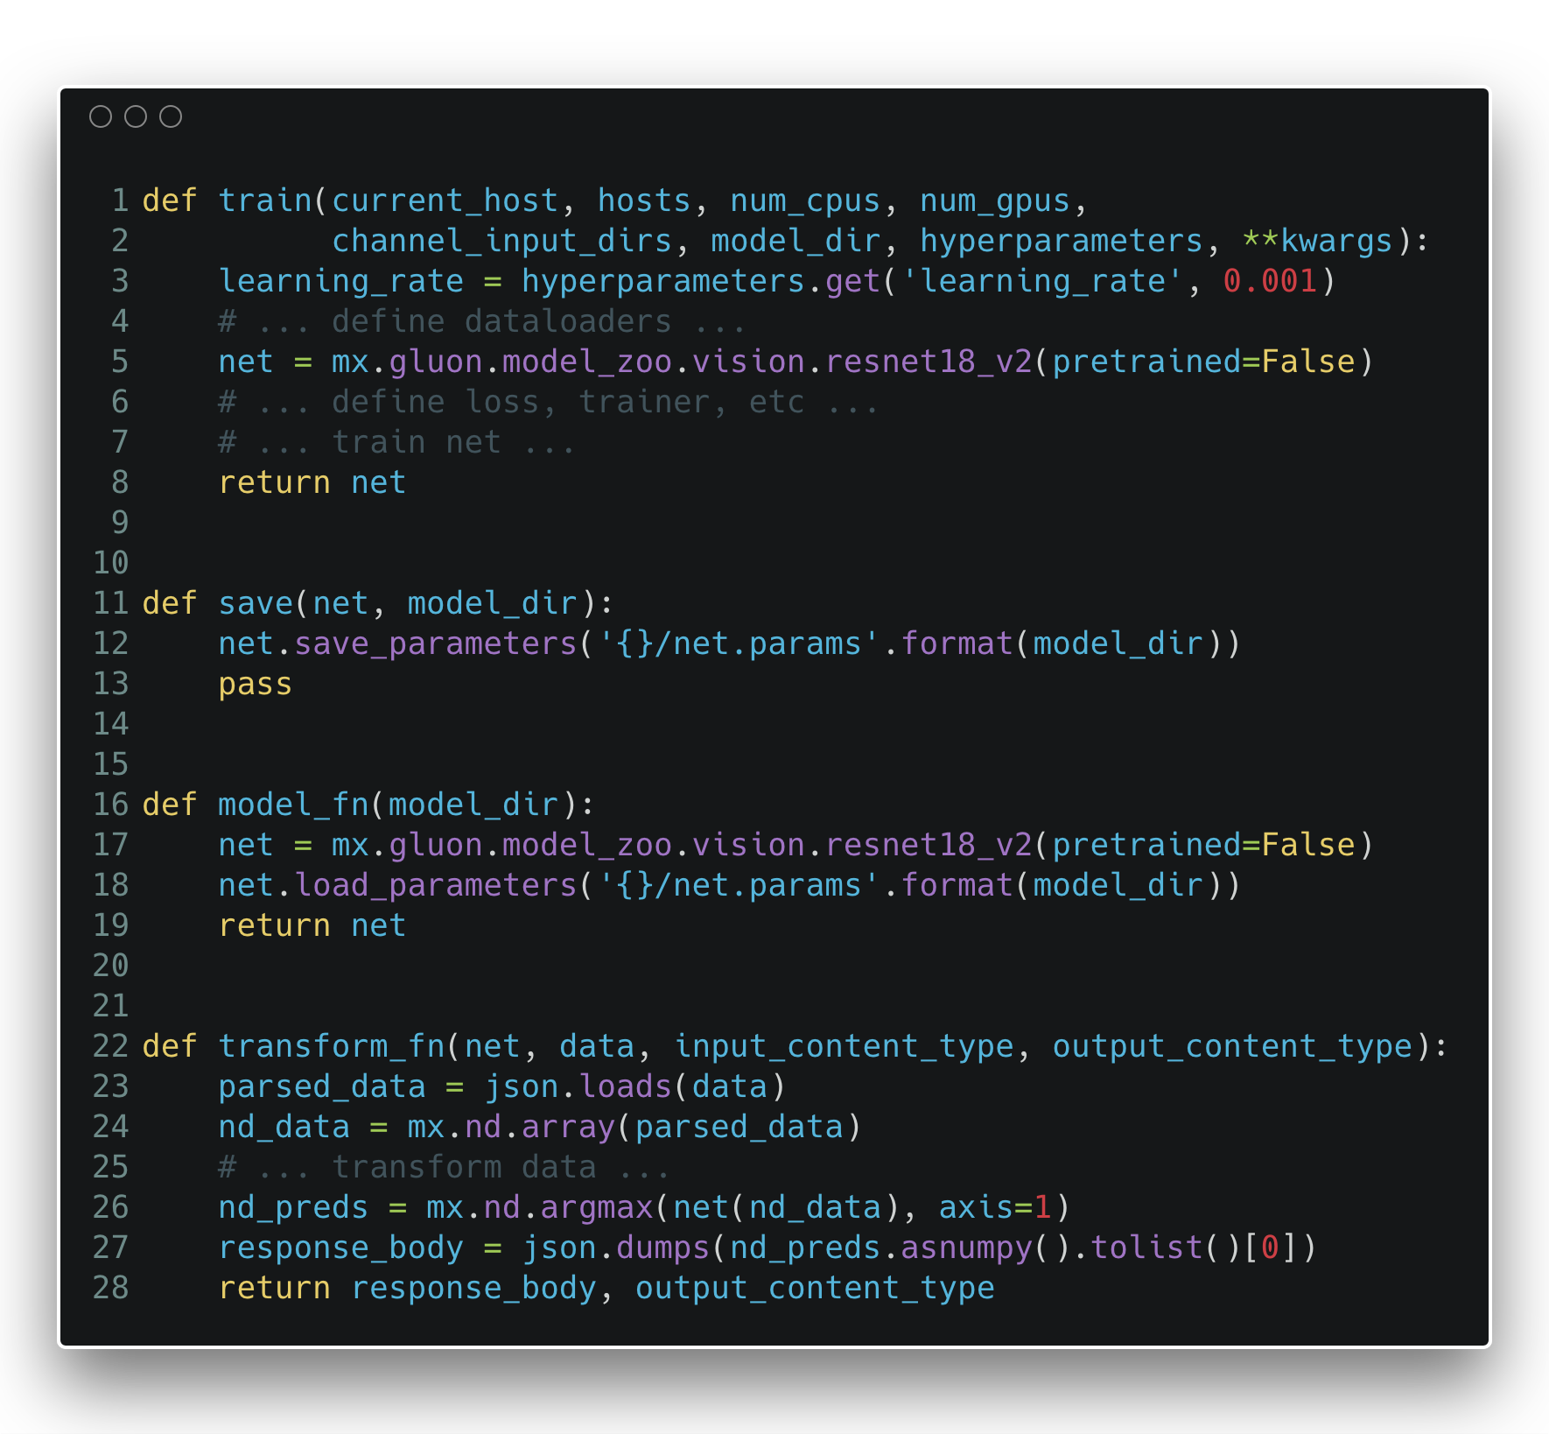
train.py

Slide 20
SageMaker walk-through with a built-in example

Slide 21
Distributed training with MXNet
KVStore₁
KVStore₂
KVStore_{m}
…
Worker₁
Worker₂
Worker_{n}
…

Slide 22
Distributed training with MXNet
KVStore₁
KVStore₂
KVStore_{m}
…
KVStore Modes
dist_sync
dist_async
dist_sync_device
dist_async_device
Worker₁
Worker₂
Worker_{n}
…

Slide 23
Distributed training with MXNet
KVStore₁
KVStore₂
KVStore_{m}
…
KVStore Modes
dist_sync
dist_async
dist_sync_device
dist_async_device
Worker₁
Worker₂
Worker_{n}
…
trainer = gluon.Trainer(net.collect_params(), 'sgd’, {'learning_rate': hyperparameters['learning_rate’]}, kvstore=kvstore)

Slide 24
SageMaker walk-through with a distributed training example

Slide 25
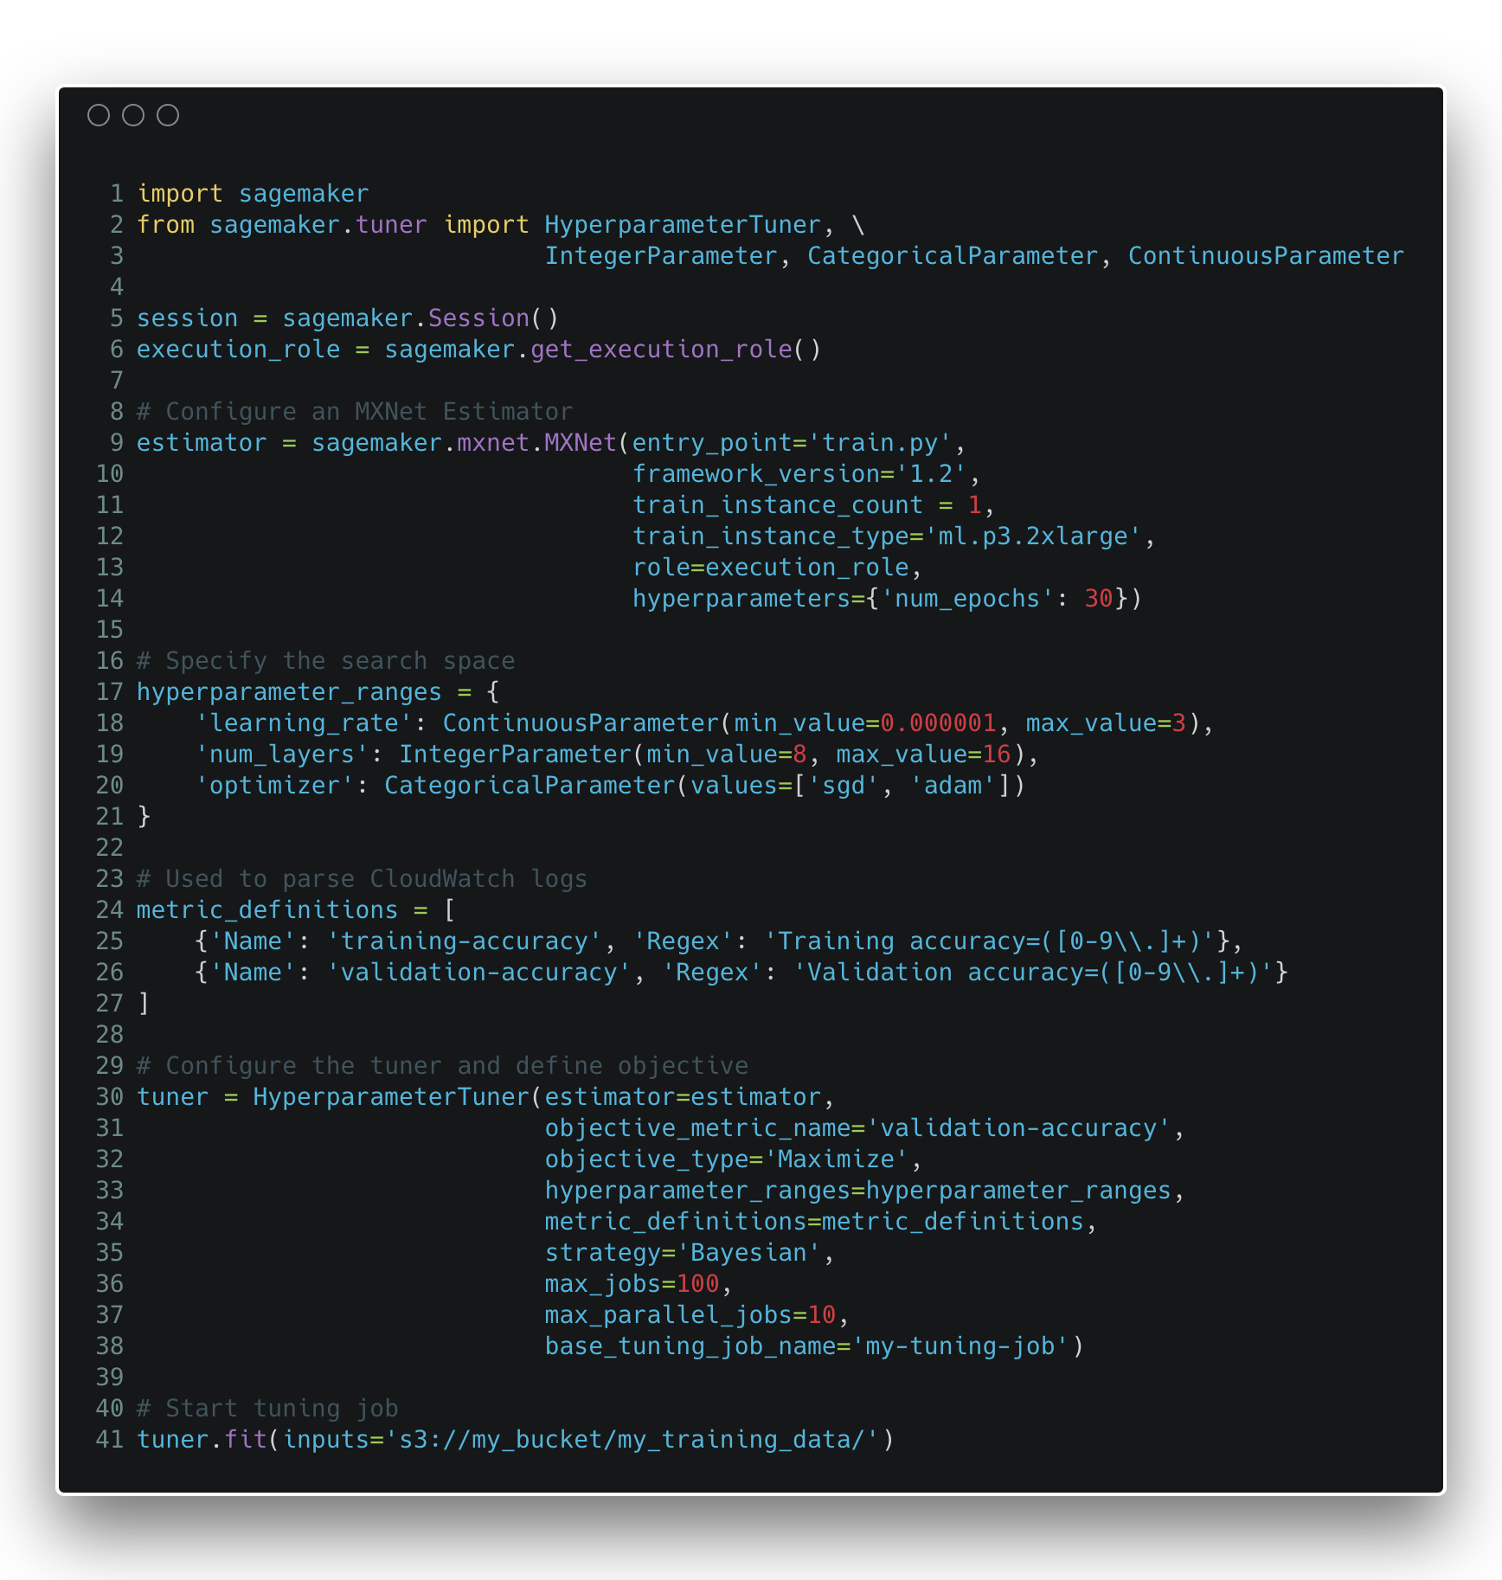
Hyperparameter optimization
Notes:
Underlying true relationship is hidden.
Cost time and money to evaluate.
Must sample.

Slide 26
Thanks! And don’t forget to check out: https://medium.com/apache-mxnet https://github.com/awslabs/amazon-sagemaker-examples

